Slide 1
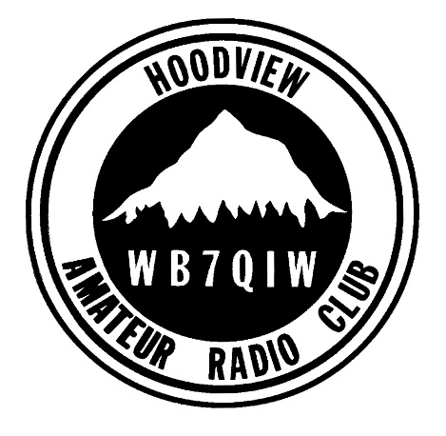
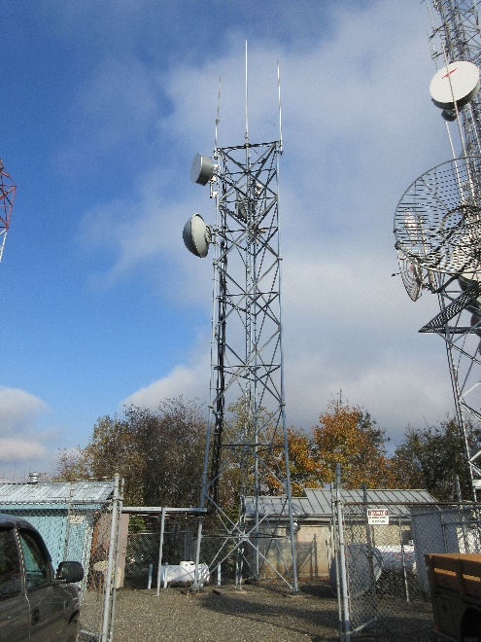
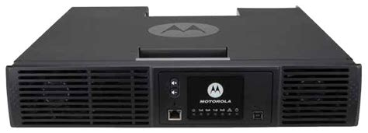
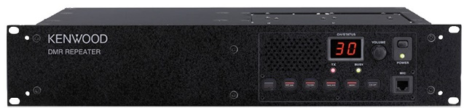
Repeaters

Slide 2
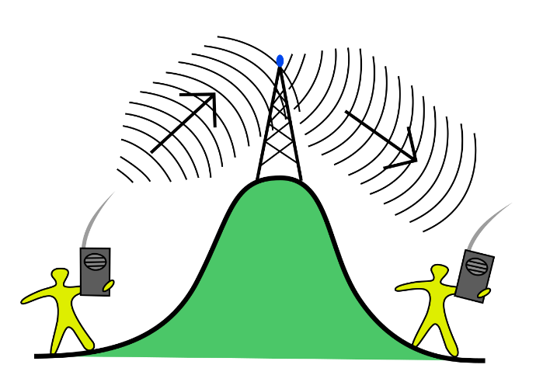
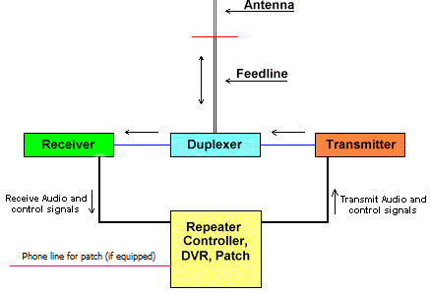
Repeaters
What’s a Repeater?
  Retransmits a Radio Signal
  Main Components:

Slide 3
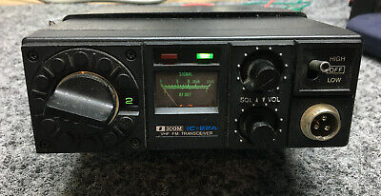
Repeaters
HARC VHF Repeater History
  First HARC Repeater Circa 1978 | 147.280+ MHz
  First HARC Repeater Site at Tower Mountain
  First HARC Commercial Repeater Site at Mount Scott
  Main Players W7AUF, WB7BDD, KV7S, W7OZM & Many Others…
  ICOM IC-22A’s at 10 Watts with Separate Antennas

Slide 4
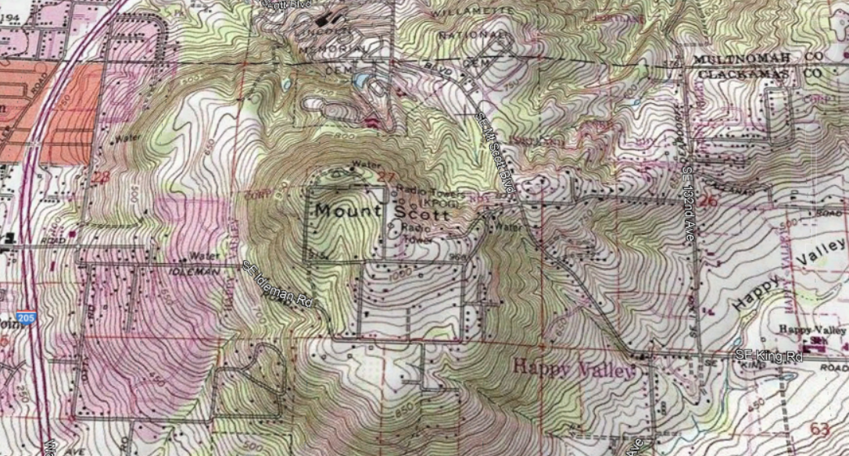
Repeaters
HARC VHF & UHF Repeaters – Mount Scott

Slide 5
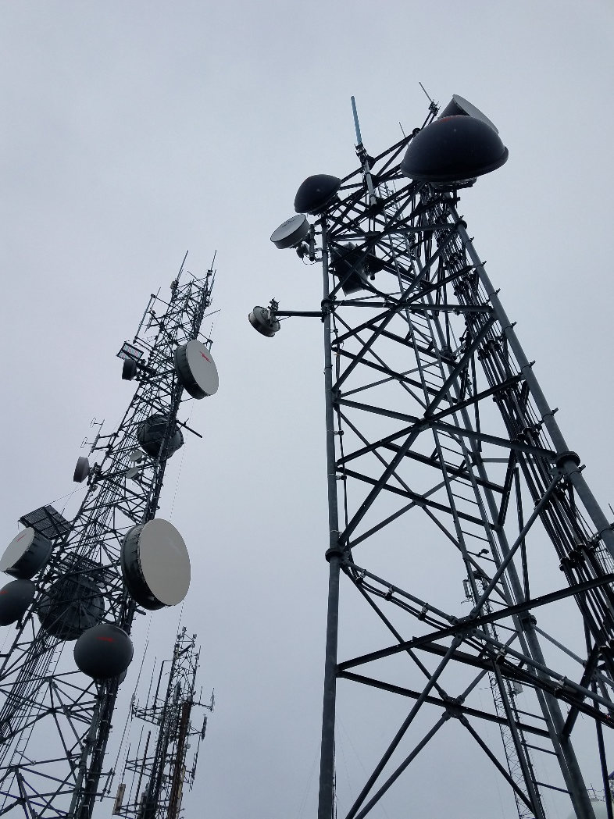
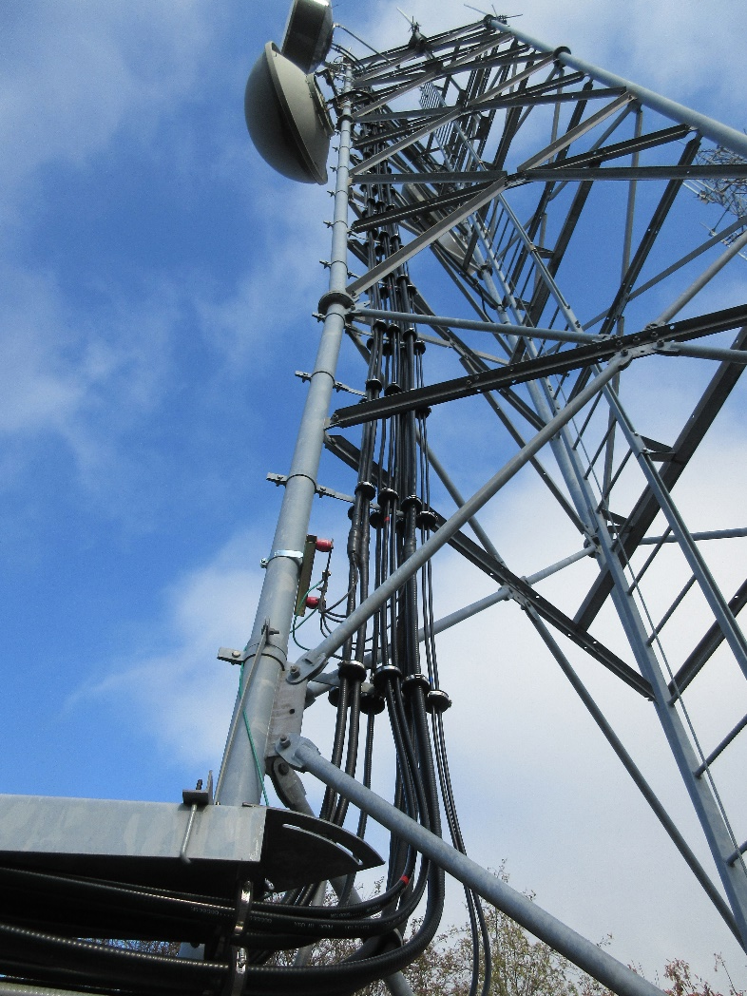
Repeaters
HARC VHF & UHF Repeaters – Mount Scott

Slide 6
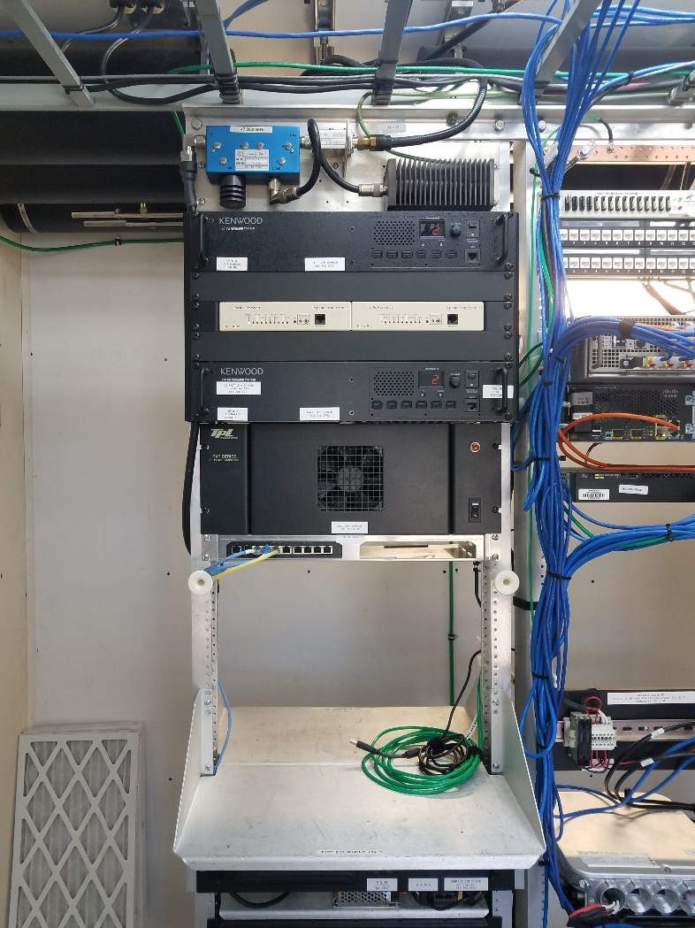
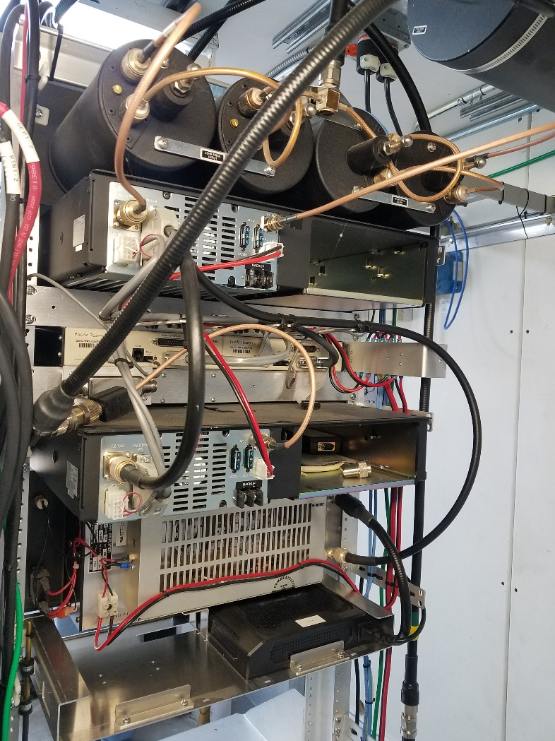
Repeaters
HARC VHF & UHF Repeaters – Mount Scott

Slide 7
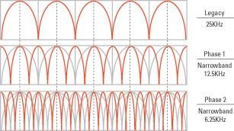
Repeaters
Common Modes – Amateur & Commercial
    Analog - Wideband (25 kHz)
    Analog - Narrowband (12.5 kHz)
    Digital - DMR
    Digital - dPMR Similar to NXDN
    Digital - D-Star
    Digital - NXDN
    Digital - P25 Phase I & Phase II
    Digital - System Fusion/Wires-X
    Digital – Tetra European Version of P25 Trunked Radio

Slide 8
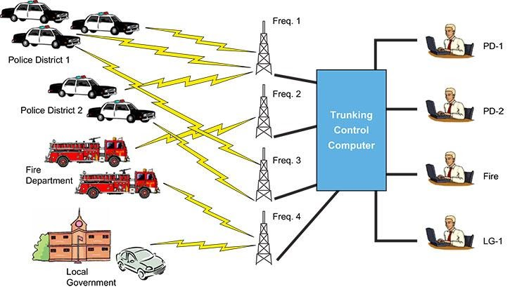
Repeaters
Conventional & Trunked

Slide 9
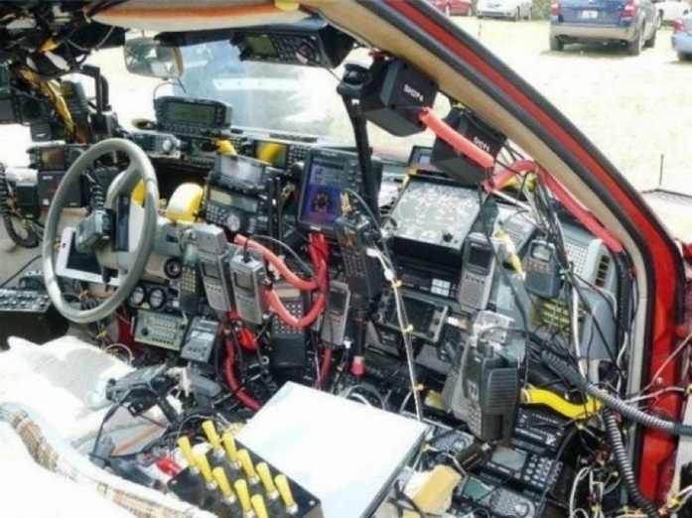
Repeaters
Most Repeaters are Quiet, Why is That?
  The Glory Years 1970’s-1980’s
  Before Cellular
  Before Talk Radio
  Before Sirius XM
  Before Podcasts
  Before Streaming
  Before Telecommuting
  ?

Slide 10
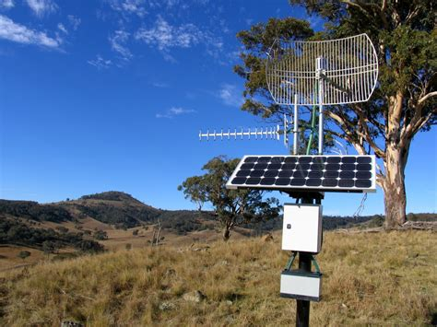
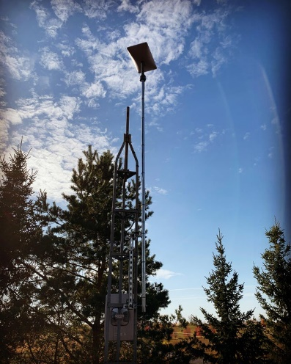
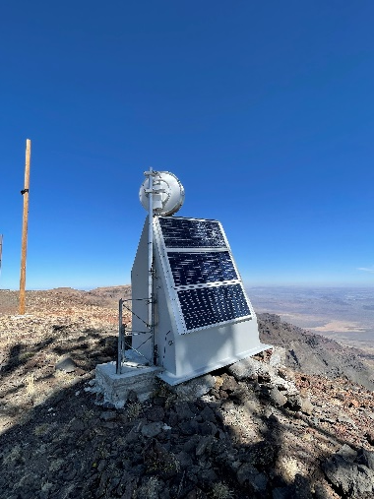
Repeaters
What’s Starting to Bring Back Repeater Activity?
  Linked Radio Networks
  Low Cost Internet Linking Repeater Technologies
  Low Cost Point-to-Point Microwave
  Low Cost Satellite VSAT’s Very-Small-Aperture Terminal
  Low Cost Cellular Modems

Slide 11


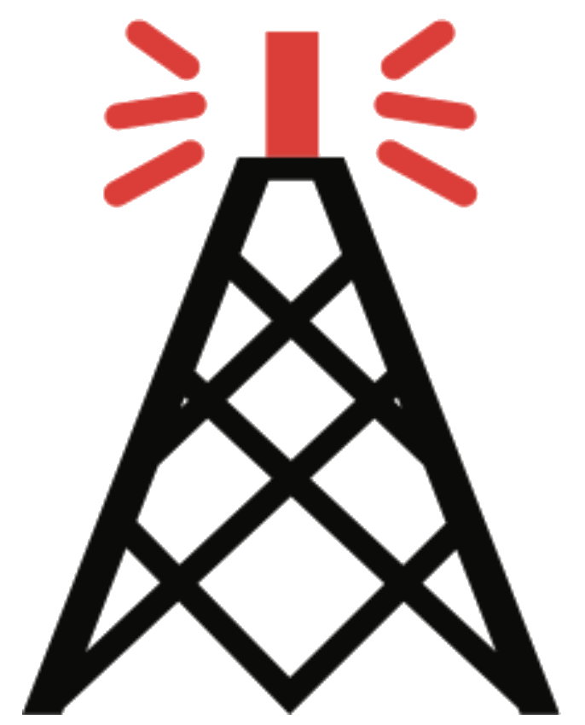
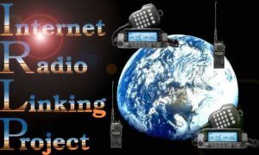


Repeaters
Internet Linking Repeater Technologies
  Allstar
  D-STAR
  Echolink
  IRLP
  DMR
  System Fusion
  Hotspots

Slide 12
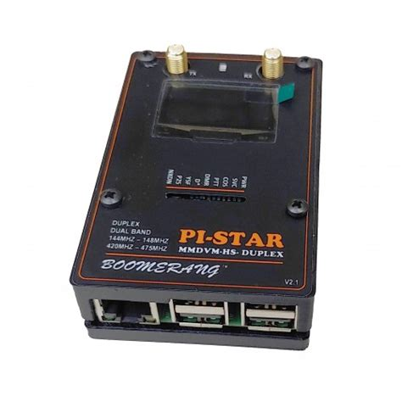
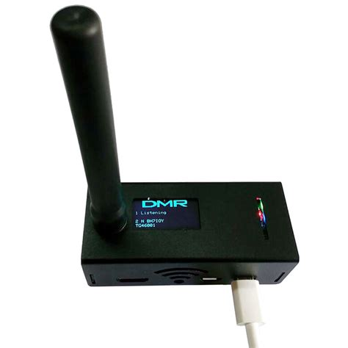
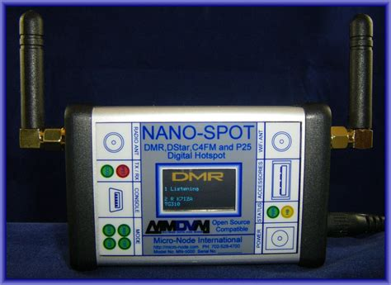
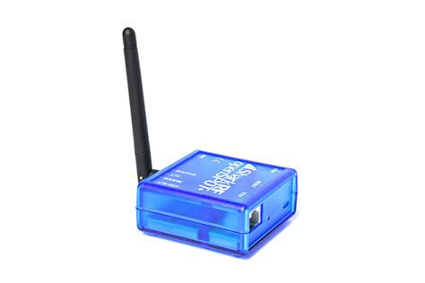
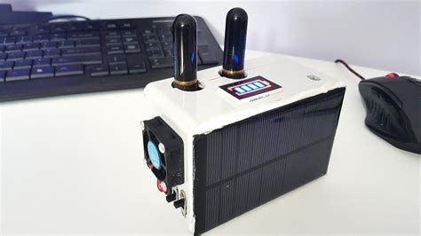
Repeaters
Hot Spots – Game Changer
  Allstar
  D-STAR
  Echolink
  IRLP
  DMR
  System Fusion

Slide 13

Repeaters
Linked Radio Systems – Local & Regional
  Amateur Radio Relay Group (K7RPT)
  RF & Internet Linking
  6 Sites / Analog
  Wide-Area Coverage, Oregon
https://arrg.org

Slide 14
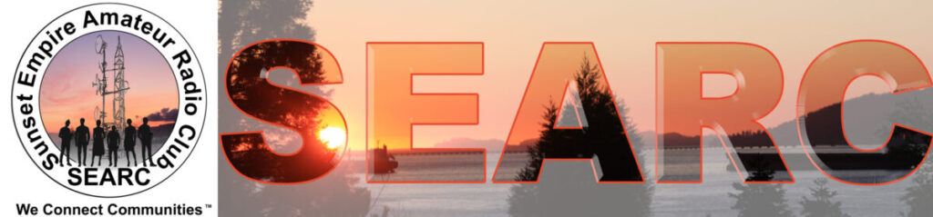
Repeaters
Linked Radio Systems – Local & Regional
  Sunset Empire Amateur Radio Club (W7BU)
  RF Linking
  6 Sites / Analog
  Wide-Area Coverage, North Oregon Coast
https://w7buhams.club/searc-radio-network

Slide 15
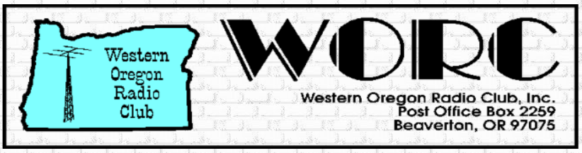
Repeaters
Linked Radio Systems – Local & Regional
  Oregon Coast Repeater Group (W7GC)
  RF Linking
  8 Sites Analog & Digital
  Wide-Area Coverage, Portland Metro
https://worc.info

Slide 16
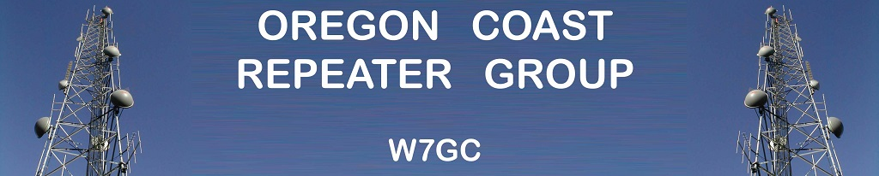
Repeaters
Linked Radio Systems – Local & Regional
  Oregon Coast Repeater Group W7GC
  RF & Internet Linking
  9 Sites / Analog
  Wide-Area Coverage, North & Central Oregon Coast
https://ocrg.org

Slide 17
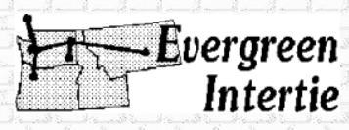
Repeaters
Linked Radio Systems – Local & Regional
  Evergreen Intertie
  RF Linking
  32 Sites / Analog
  Wide-Area Coverage, Washington, Oregon, Idaho, Montana & Wyoming
http://www.worc.info/evergreen%20intertie%20information.htm

Slide 18
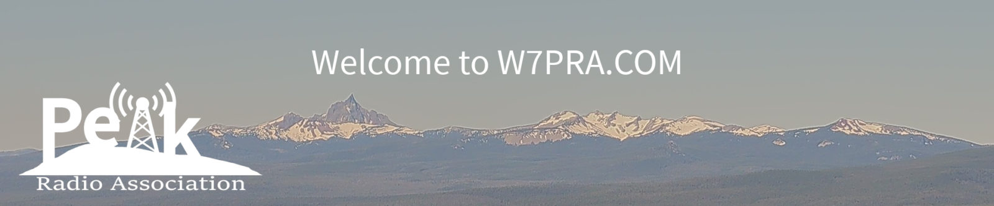
Repeaters
Linked Radio Systems – Local & Regional
  Peak Radio Association (W7PRA)
  Allstar Linking
  49 Sites / Analog
  Wide-Area Coverage, California, Oregon & Washington
https://w7pra.com

Slide 19

Repeaters
Linked Radio Systems – Local & Regional
  Pacific Northwest Digital (WA7DMR)
  Internet Linking
  66 Sites / Digital
  Wide-Area Coverage, Idaho, Oregon & Washington
https://pnwdigital.net

Slide 20
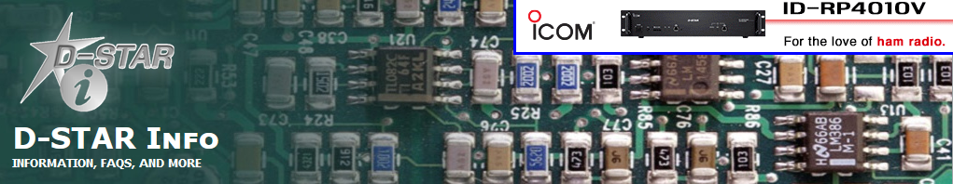
Repeaters
Linked Radio Systems – Large Networks
  D-STAR
  Internet Linking
  968+ Repeaters USA
  Wide-Area Coverage, Nation-Wide & World-Wide
http://dstarinfo.com

Slide 21

Repeaters
Linked Radio Systems – Large Networks
  System Fusion (Yaesu Implementation of Digital Amateur Radio)
  Internet Linking
  3277+ Repeaters USA
  Wide-Area Coverage, Nation-Wide & World-Wide
systemfusion.yaesu.com

Slide 22
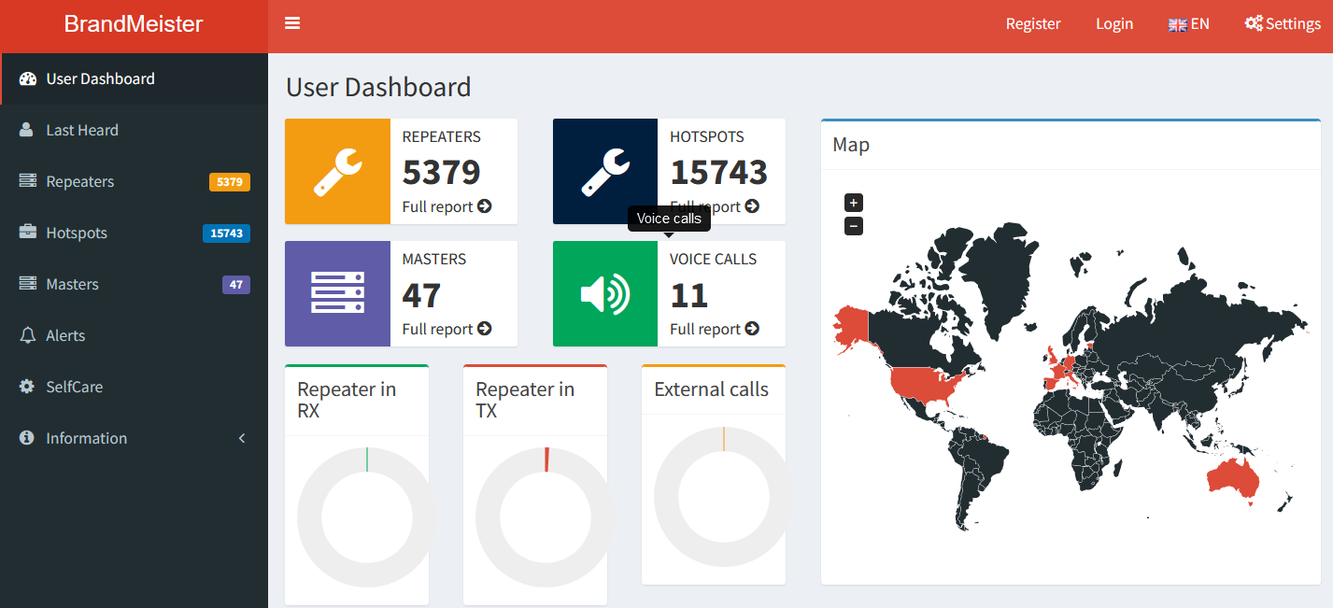
Repeaters
Linked Radio Systems – Large Networks
  BrandMeister (DMR)
  Internet Linking
  5379+ Repeaters & 15,743+ Hotspots
  Wide-Area Coverage, Nation-Wide & World-Wide
https://brandmeister.network

Slide 23
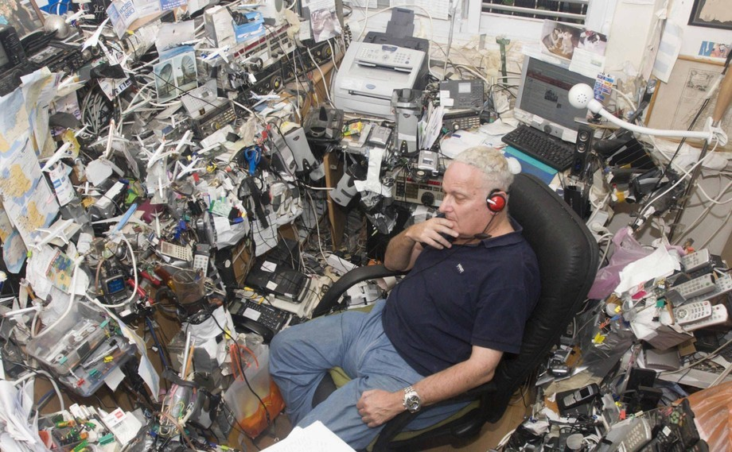
Questions?

